Slide 1

COS3023 Operating Systems and Concurrency
Topic 5- File System : File System Interface (Part 1)
Lecturer : Ms. Sha

Slide 2
Objectives
To explain the function of file systems
To describe the interfaces to file systems
To discuss file-system design tradeoffs, including access methods, file sharing, file locking, and directory structures
To explore file-system protection

Slide 3
Presentation Outline
File Concept
Access Methods
Directory Structure
File-System Mounting
File Sharing
Protection

Slide 4
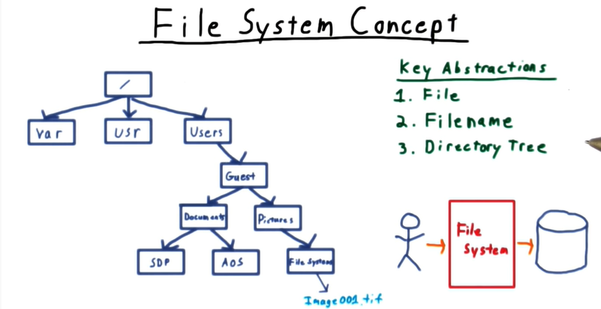

Slide 5
File Concept
Files are the most important mechanism for storing data permanently on devices.
Contiguous logical address space
Store:
Data
numeric
character
binary
Program

Slide 6
File Structure
None - sequence of words, bytes
Simple record structure
Lines
Fixed length
Variable length
Complex Structures
Formatted document
Relocatable load file
Who decides:
Operating system
Program

Slide 7
File Attributes
Name – only information kept in human-readable form
Identifier – unique tag (number) identifies file within file system
Type – needed for systems that support different types
Location – pointer to file location on device
Size – current file size
Protection – controls who can do reading, writing, executing
Time, date, and user identification – data for protection, security, and usage monitoring
Information about files are kept in the directory structure, which is maintained on the disk

Slide 8
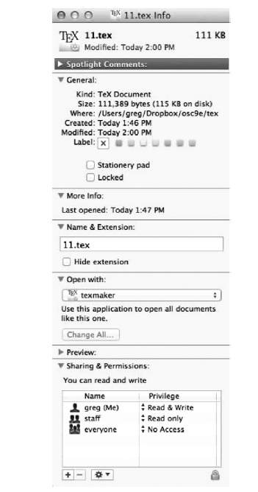

Slide 9
File Operations
File is an abstract data type CRWD
Create
Delete
Read
Write
Reposition within file
Truncate
Open(F_{i}) – search the directory structure on disk for entry F_{i}, and move the content of entry to memory
Close (F_{i}) – move the content of entry F_{i} in memory to directory structure on disk

Slide 10
Open Files
Several pieces of data are needed to manage open files: POLA
File pointer: pointer to last read/write location, per process that has the file open.
File-open count: counter of number of times a file is open – to allow removal of data from open-file table when last processes closes it.
Disk location of the file: cache of data access information.
Access rights: per-process access mode information.

Slide 11
Open File Locking
Provided by some operating systems and file systems
Mediates access to a file
Mandatory or advisory:
Mandatory – access is denied depending on locks held and requested.
Advisory – processes can find status of locks and decide what to do.

Slide 12
File Locking Example – Java API
import java.io.*;
import java.nio.channels.*;
public class LockingExample {
public static final boolean EXCLUSIVE = false;
public static final boolean SHARED = true;
public static void main(String arsg[]) throws IOException {
FileLock sharedLock = null;
FileLock exclusiveLock = null;
try {
RandomAccessFile raf = new RandomAccessFile("file.txt", "rw");
// get the channel for the file
FileChannel ch = raf.getChannel();
// this locks the first half of the file - exclusive
exclusiveLock = ch.lock(0, raf.length()/2, EXCLUSIVE);
/** Now modify the data . . . */
// release the lock
exclusiveLock.release();

Slide 13
File Locking Example – Java API (cont)
// this locks the second half of the file - shared
sharedLock = ch.lock(raf.length()/2+1, raf.length(), SHARED);
/** Now read the data . . . */
// release the lock
exclusiveLock.release();
} catch (java.io.IOException ioe) {
System.err.println(ioe);
}finally {
if (exclusiveLock != null)
exclusiveLock.release();
if (sharedLock != null)
sharedLock.release();
}
}
}

Slide 14
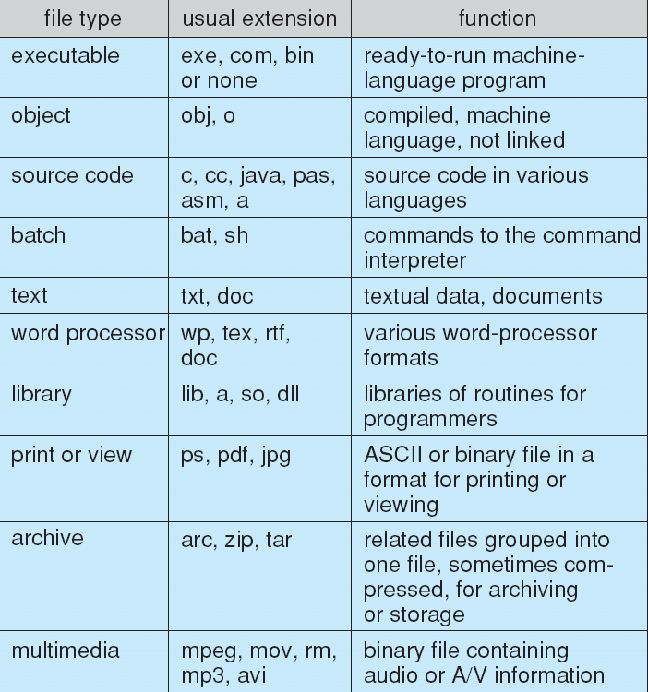
File Types – Name, Extension

Slide 15
Access Methods
Sequential Access
read next
write next
reset
no read after last write (rewrite)
Direct Access
read n
write n
position to n
read next
write next
rewrite n
n = relative block number
Indexed Sequential Access. It is built on top of Sequential access.

Slide 16
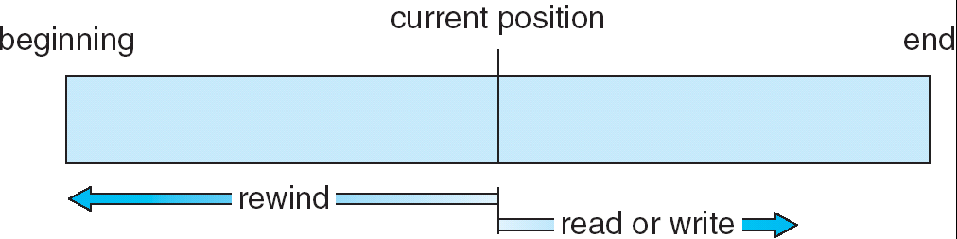
Sequential-access File

Slide 17
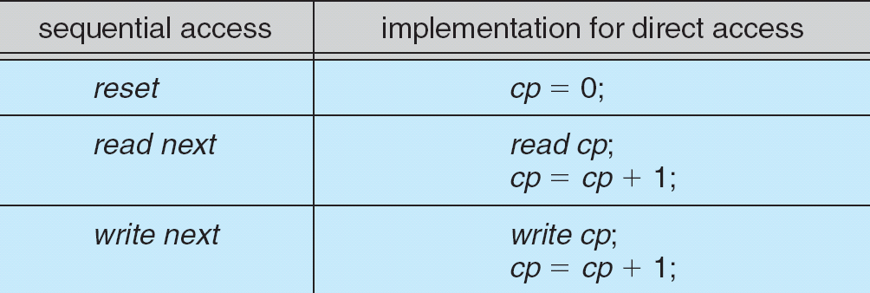
Simulation of Sequential Access on a Direct-access File

Slide 18
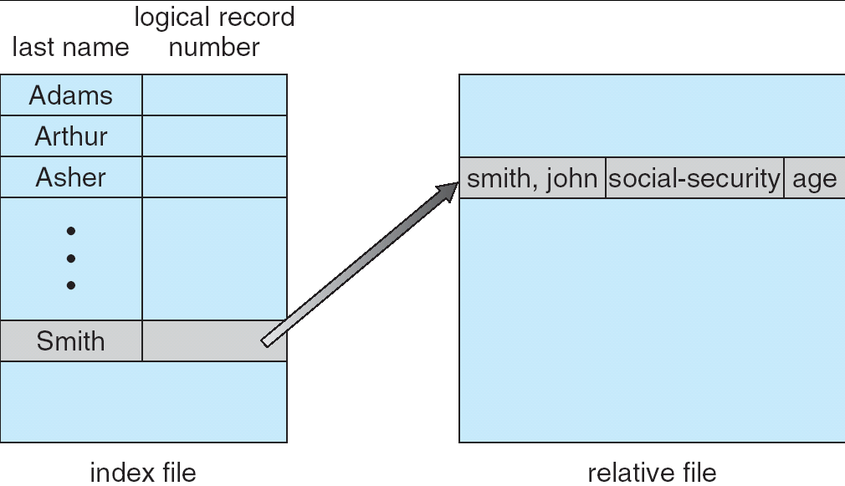
Example of Index and Relative Files

Slide 19
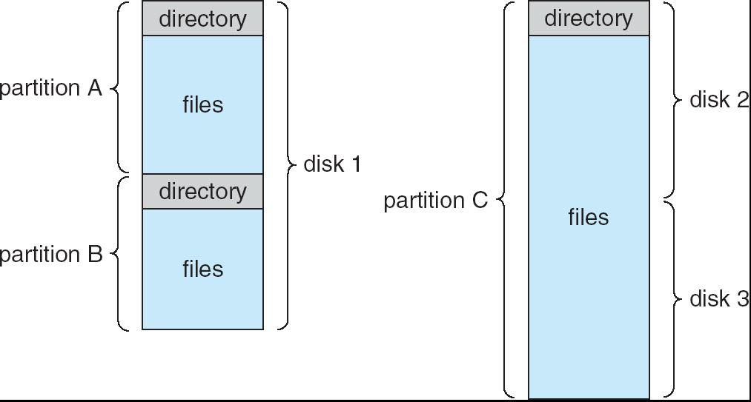
A Typical File-system Organization
Volume: Any entity/disk space that contains a file system

Slide 20
Directory Structure
A collection of nodes containing information about all files within it
Directory
Files
F 1
F 2
F 3
F 4
F n
Both the directory structure and the files reside on disk
Backups of these two structures are kept on tapes
Notes:
Single-level directory
Two-level directory
Tree-structured directory
Acyclic-graph directory
General-graph directory

Slide 21
Operations Performed on Directory
Create a file
Delete a file
Rename a file
Search for a file
List a directory
Traverse the file system

Slide 22
Organize the Directory (Logically) to Obtain
Efficiency – locating a file quickly
Naming – convenient to users
Two users can have same name for different files
The same file can have several different names
Grouping – logical grouping of files by properties, (e.g., all Java programs, all games, …)

Slide 23
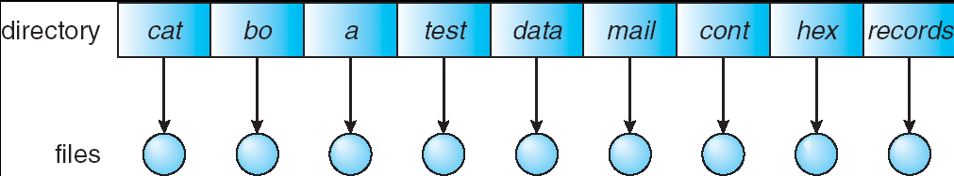
Single-Level Directory
A single directory for all users
Simple to implement
Disadv.:
Directory naming problem
Grouping problem

Slide 24
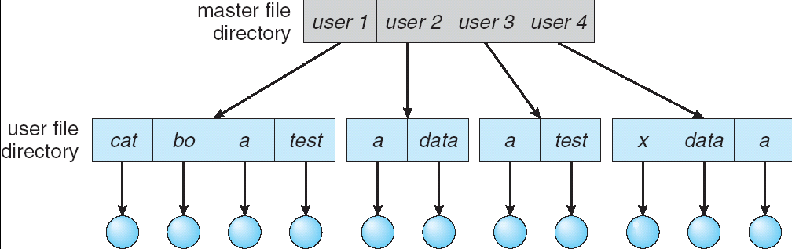
Two-Level Directory
Separate directory for each user
Path name
Can have the same file directory name for different user
Efficient searching
No grouping capability

Slide 25
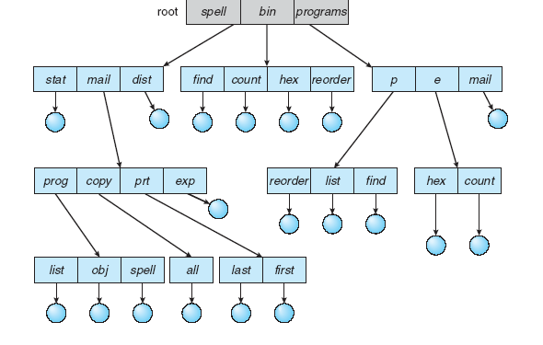
Tree-Structured Directories

Slide 26
Tree-Structured Directories (Cont)
Efficient searching
Grouping Capability
Current directory (working directory)
cd /spell/mail/prog
type list

Slide 27
Tree-Structured Directories (Cont)
Absolute or relative path name
Creating a new file is done in current directory
Delete a file
rm <file-name>
Creating a new subdirectory is done in current directory
mkdir <dir-name>
Example: if in current directory /mail
mkdir count
mail
prog
copy
prt
exp
count
Deleting “mail” ⇒ deleting the entire subtree rooted by “mail”

Slide 28
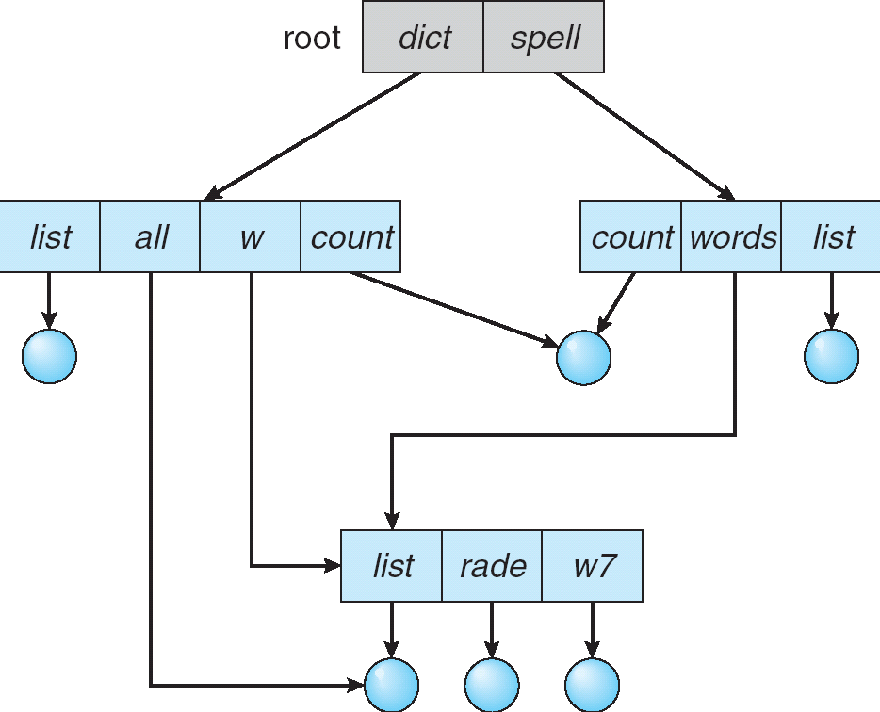
Acyclic-Graph Directory
Have shared subdirectories and files
links
links
Notes:
Links: Enable multiple directories to be directed to the same file contents
-Hard links
-Symbolic links/ Soft links
http://www.differencebetween.net/technology/difference-between-soft-link-and-hard-link-in-unix-in-os/

Slide 29
Acyclic-Graph Directory (Cont.)
Two different names (aliasing)
If dict deletes list ⇒ dangling pointer
Solutions:
Backpointers, so we can delete all pointers (though variable size records are a problem)
Backpointers using a daisy chain organization
New directory entry type
Link – another name (pointer) to an existing file
Resolve the link – follow pointer to locate the file

Slide 30
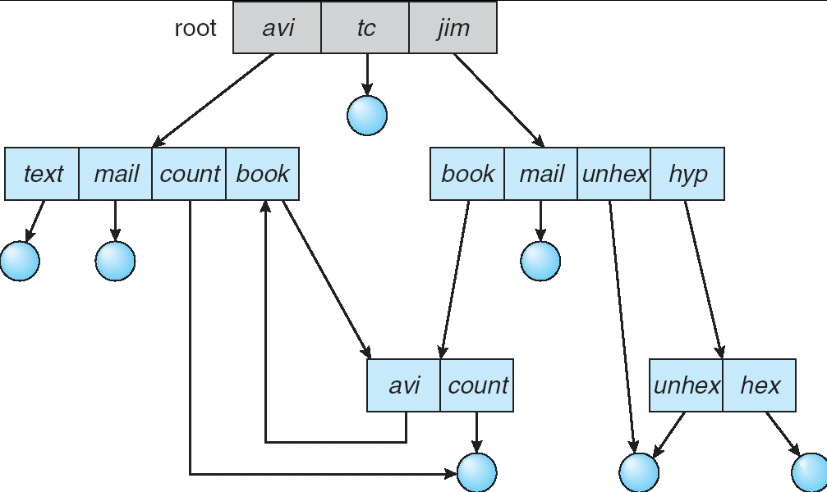
General Graph Directory

Slide 31
General Graph Directory (Cont.)
How do we guarantee no cycles?
Allow only links to file not subdirectories
Garbage collection for useless memory and resources
Use a cycle detection algorithm to determine whether it is okay every time a new link is added.

Slide 32
File System Mounting
A file system must be mounted before it can be accessed
An unmounted file system (i.e. Fig. 11-11(b)) is mounted at a mount point

Slide 33
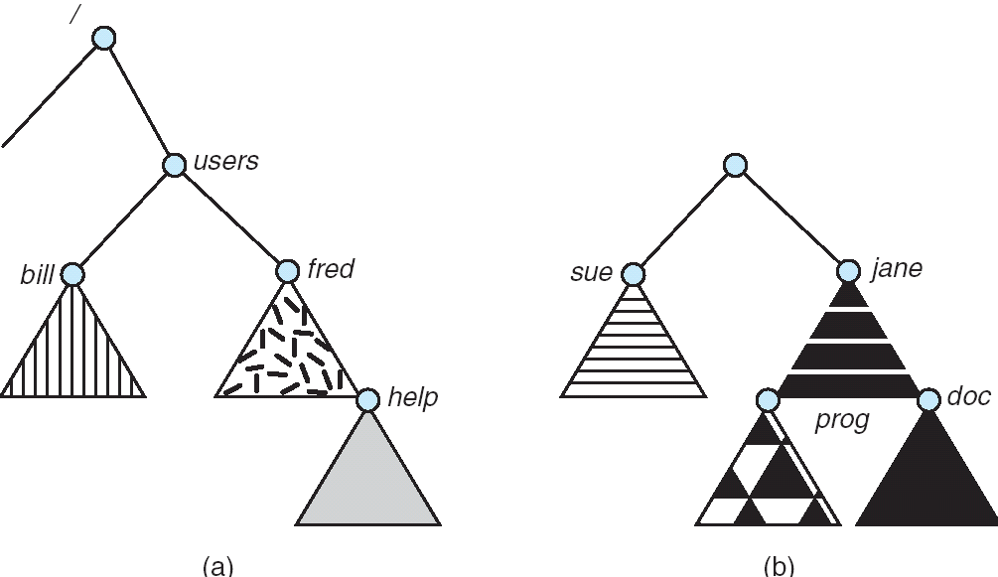
(a) Existing. (b) Unmounted Partition

Slide 34
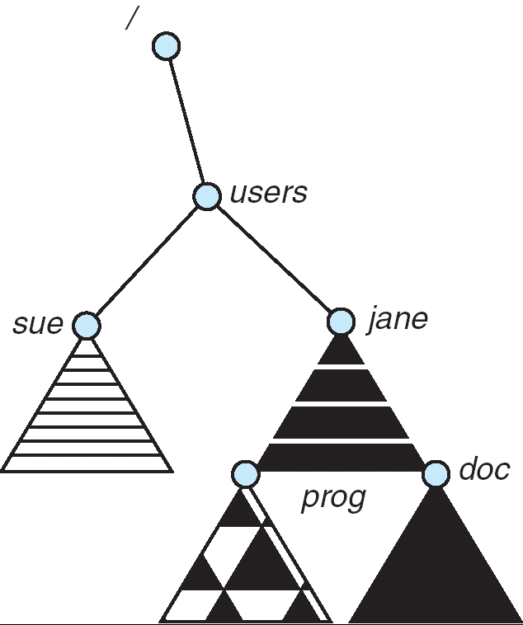
Mount Point

Slide 35
File Sharing
Sharing of files on multi-user systems is desirable
Sharing may be done through a protection scheme
On distributed systems, files may be shared across a network
Network File System (NFS) is a common distributed file-sharing method

Slide 36
File Sharing – Multiple Users
User IDs identify users, allowing permissions and protections to be per-user
Group IDs allow users to be in groups, permitting group access rights

Slide 37
File Sharing – Remote File Systems
Uses networking to allow file system access between systems
Manually via programs like FTP
Automatically, seamlessly using distributed file systems
Semi automatically via the world wide web
Client-server model allows clients to mount remote file systems from servers
Server can serve multiple clients
Client and user-on-client identification is insecure or complicated
NFS is standard UNIX client-server file sharing protocol
CIFS (Common Internet File System) is standard Windows protocol
Standard operating system file calls are translated into remote calls
Distributed Information Systems (distributed naming services) such as LDAP, DNS, NIS, Active Directory implement unified access to information needed for remote computing

Slide 38
File Sharing – Failure Modes
Remote file systems add new failure modes, due to network failure, server failure
Recovery from failure can involve state information about status of each remote request
Stateless protocols such as NFS include all information in each request, allowing easy recovery but less security

Slide 39
File Sharing – Consistency Semantics
Consistency semantics specify how multiple users are to access a shared file simultaneously
Andrew File System (AFS) implemented complex remote file sharing semantics.
Unix file system (UFS) implements:
Writes to an open file visible immediately to other users of the same open file.
Sharing file pointer to allow multiple users to read and write concurrently.
AFS has session semantics
Writes only visible to sessions starting after the file is closed.

Slide 40
Protection
File owner/creator should be able to control:
what can be done
by whom
Types of access
Read
Write
Execute
Append
Delete
List

Slide 41
Access Lists and Groups
Mode of access: read, write, execute
Three classes of users
RWX
a) owner access 7 ⇒ 1 1 1 RWX
b) group access 6 ⇒ 1 1 0
RWX
c) public access 1 ⇒ 0 0 1
Ask manager to create a group (unique name), say G, and add some users to the group.
For a particular file (say game) or subdirectory, define an appropriate access.
owner
group
public
chmod
761
game
Attach a group to a file chgrp G game

Slide 42
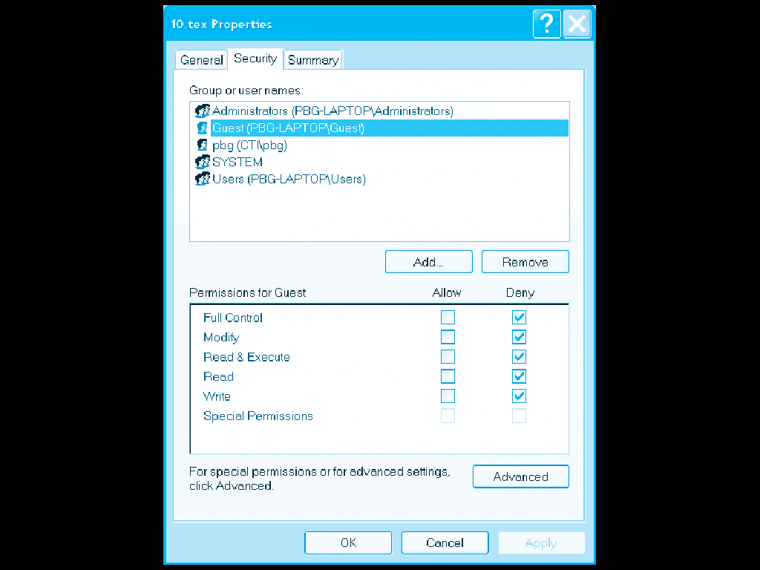
Windows XP Access-control List Management

Slide 43
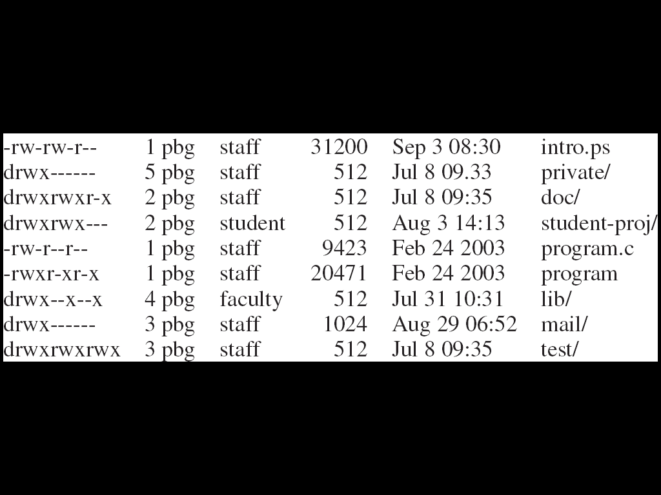
A Sample UNIX Directory Listing

Slide 44

THANK YOU

